Slide 1


K.RAMAKRISHNAN COLLEGE OF TECHNOLOGY (AUTONOMOUS), TRICHY
Forecasting Next Week's Temperatures Using a Simple Moving Average
PRESENTED BY
SATHIYAJITH AASHIM G
(2303811724321098)

Slide 2
PRESENTATION OVERVIEW
Problem Identification
Objective
Proposed system
Block diagram of proposed system
R concept used
Advantages of proposed system
Modules
Modules implementation
Output

Slide 3
PROBLEM IDENTIFICATION
Accurately predicting short-term weather trends can be challenging without proper tools. Many existing systems are complex or lack user-friendly interfaces, making it hard for users to analyze historical temperature data and forecast upcoming conditions effectively.

Slide 4
OBJECTIVE
To develop an R Shiny application that forecasts future temperatures for a selected location using the Simple Moving Average (SMA) technique, allowing users to visualize trends and make informed decisions based on historical weather data.

Slide 5
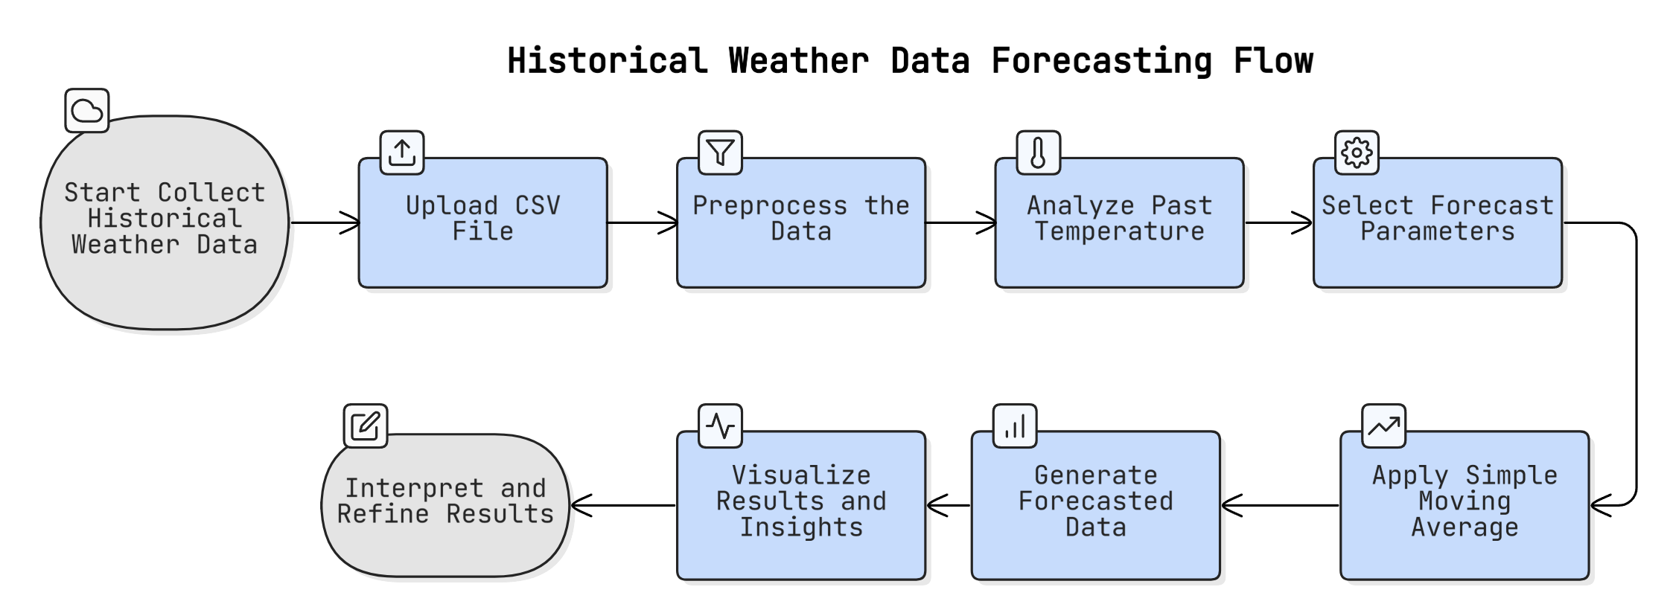
PROPOSED SYSTEM
BLOCK DIAGRAM

Slide 6
R CONCEPT USED
Reactive programming with Shiny for dynamic, real-time interaction
Data manipulation and filtering using dplyr
Date conversion and handling with as.Date()
Simple Moving Average calculation via rollmean() from the zoo package
Data visualization with colorful line plots using ggplot2

Slide 7
ADVANTAGES OF PROPOSED SYSTEM
User-Friendly Interface:
Intuitive design with easy CSV upload and simple input controls for forecasting parameters.
Interactive and Real-Time:
Dynamic updates and visualizations based on user input provide immediate feedback.
Customizable Forecasting:
Allows users to select location, forecast start date, forecast duration, and SMA window size for tailored analysis.
Extensible:
Modular design supports future integration with databases or other forecasting models.
Multi-location Support:
Handles temperature data for multiple locations within the same app.

Slide 8
MODULES
File Upload & Input.
Interface Data Processing and SMA Logic
Forecast Generation
Visualization and Insight

Slide 9
MODULES
File Upload & Selection
Upload past weather data
Choose location, date, and forecast window
SMA Calculation
Compute rolling mean over specified window

Slide 10
MODULES
Forecast Generation
Predict next n days using last SMA
Visualization & Insight
Line chart (actual vs forecast)
Tabular forecast
Trend detection (Rising/Dropping/Stable)

Slide 11
MODULES IMPLEMENTATION
Technology Stack:
Frontend: R Shiny (UI layout and interactivity)
Backend: R (data processing, SMA calculation)
Libraries Used: shiny, ggplot2
Features Implemented:
Colorful two-tab UI (input/output separated)
Interactive chart and dynamic insights
Forecast using last known SMA values

Slide 12
MODULES IMPLEMENTATION
Demo Highlights:
Upload CSV file
Select “PLACE”, SMA window = 3, Forecast Days = 7
Click “Generate Forecast”
Visual output with colored trend indicators and data table

Slide 13
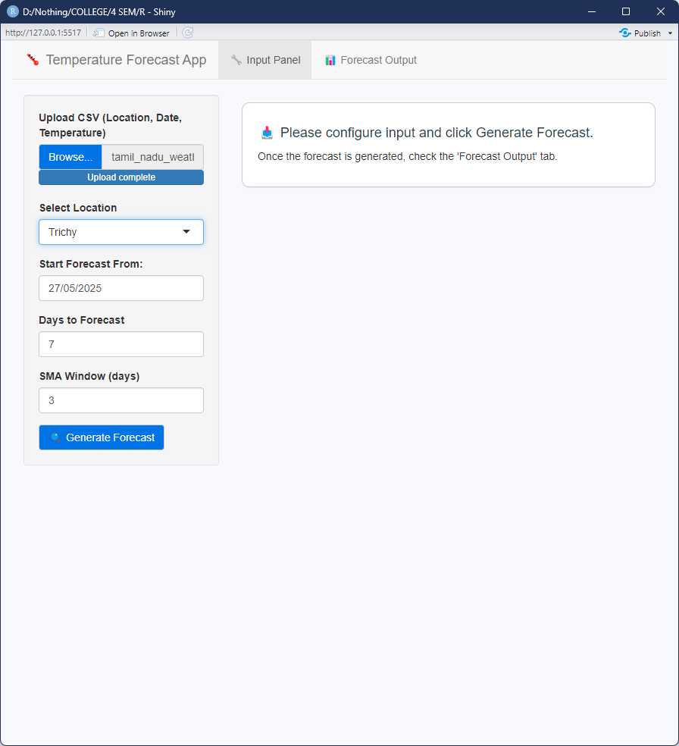
OUTPUT

Slide 14
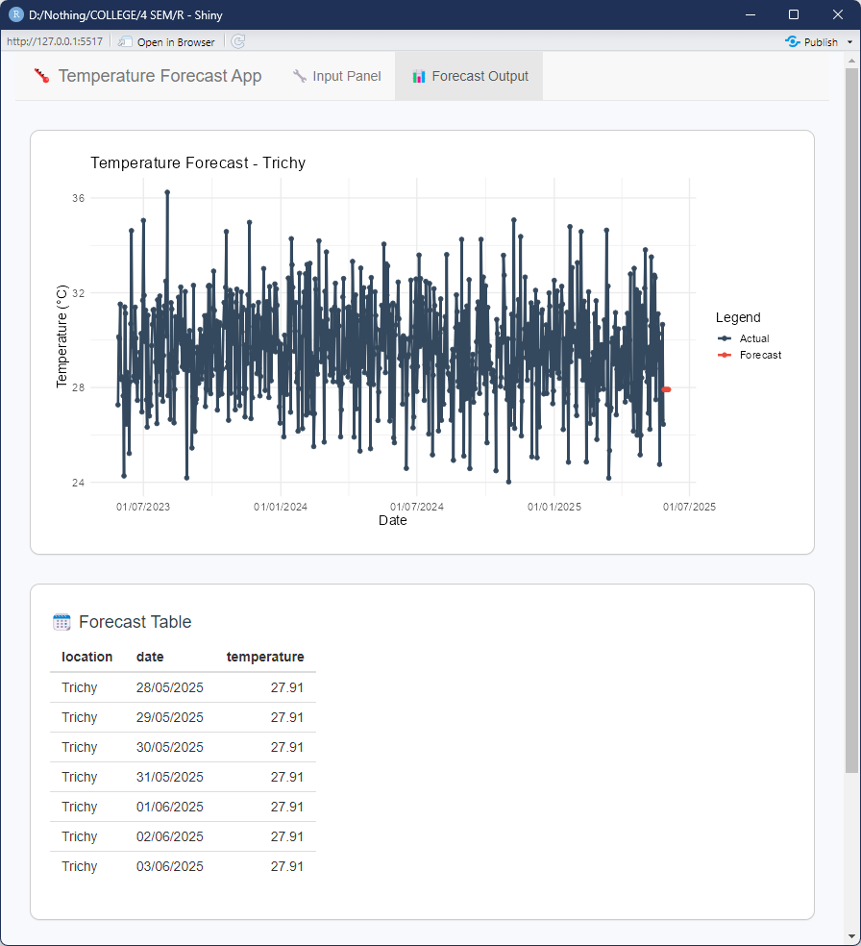
OUTPUT

Slide 15
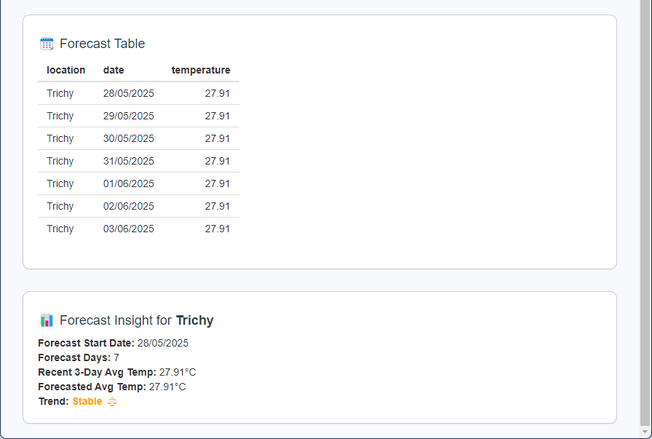
OUTPUT

Slide 16
Thank You
ANY QUERIES???

